Slide 1


At the service of internationalisation

Slide 2


ICEX has:
A VISION: to continue being a key reference in the support system for internationalisation, reinforcing its position and ensuring the reliability and trustworthiness that companies require.
A MISSION: to support companies, the training of professionals and the attraction of foreign investment to enhance the internationalisation of the Spanish economy and accelerate a more inclusive and sustainable economic growth, with high quality employment.
A COMMAND: to optimise the use of public and private resources to maximise efficiency in the services provided to companies in terms of its impact.
Vision, mission, command

Slide 3

Our Values:
TO SUPPORT companies, the training of professionals and the attraction of foreign investment to enhance the internationalisation of the Spanish economy and
TO ACCELERATE a more INCLUSIVE and SUSTAINABLE economic growth,
with quality employment.
Values
3

Slide 4

Accompained by
the most
experienced team
Over 600 specialised
professionals all over the world.
The team

Slide 5

In close contact
with companies
31 Territorial and Provincial
Commercial Offices in Spain.
Close contact

Slide 6

Taking companies
to all five continents
Hand in hand with 100 Spanish Economic and Commercial Offices all over the world, creating the largest foreign network.
Foreign network

Slide 7
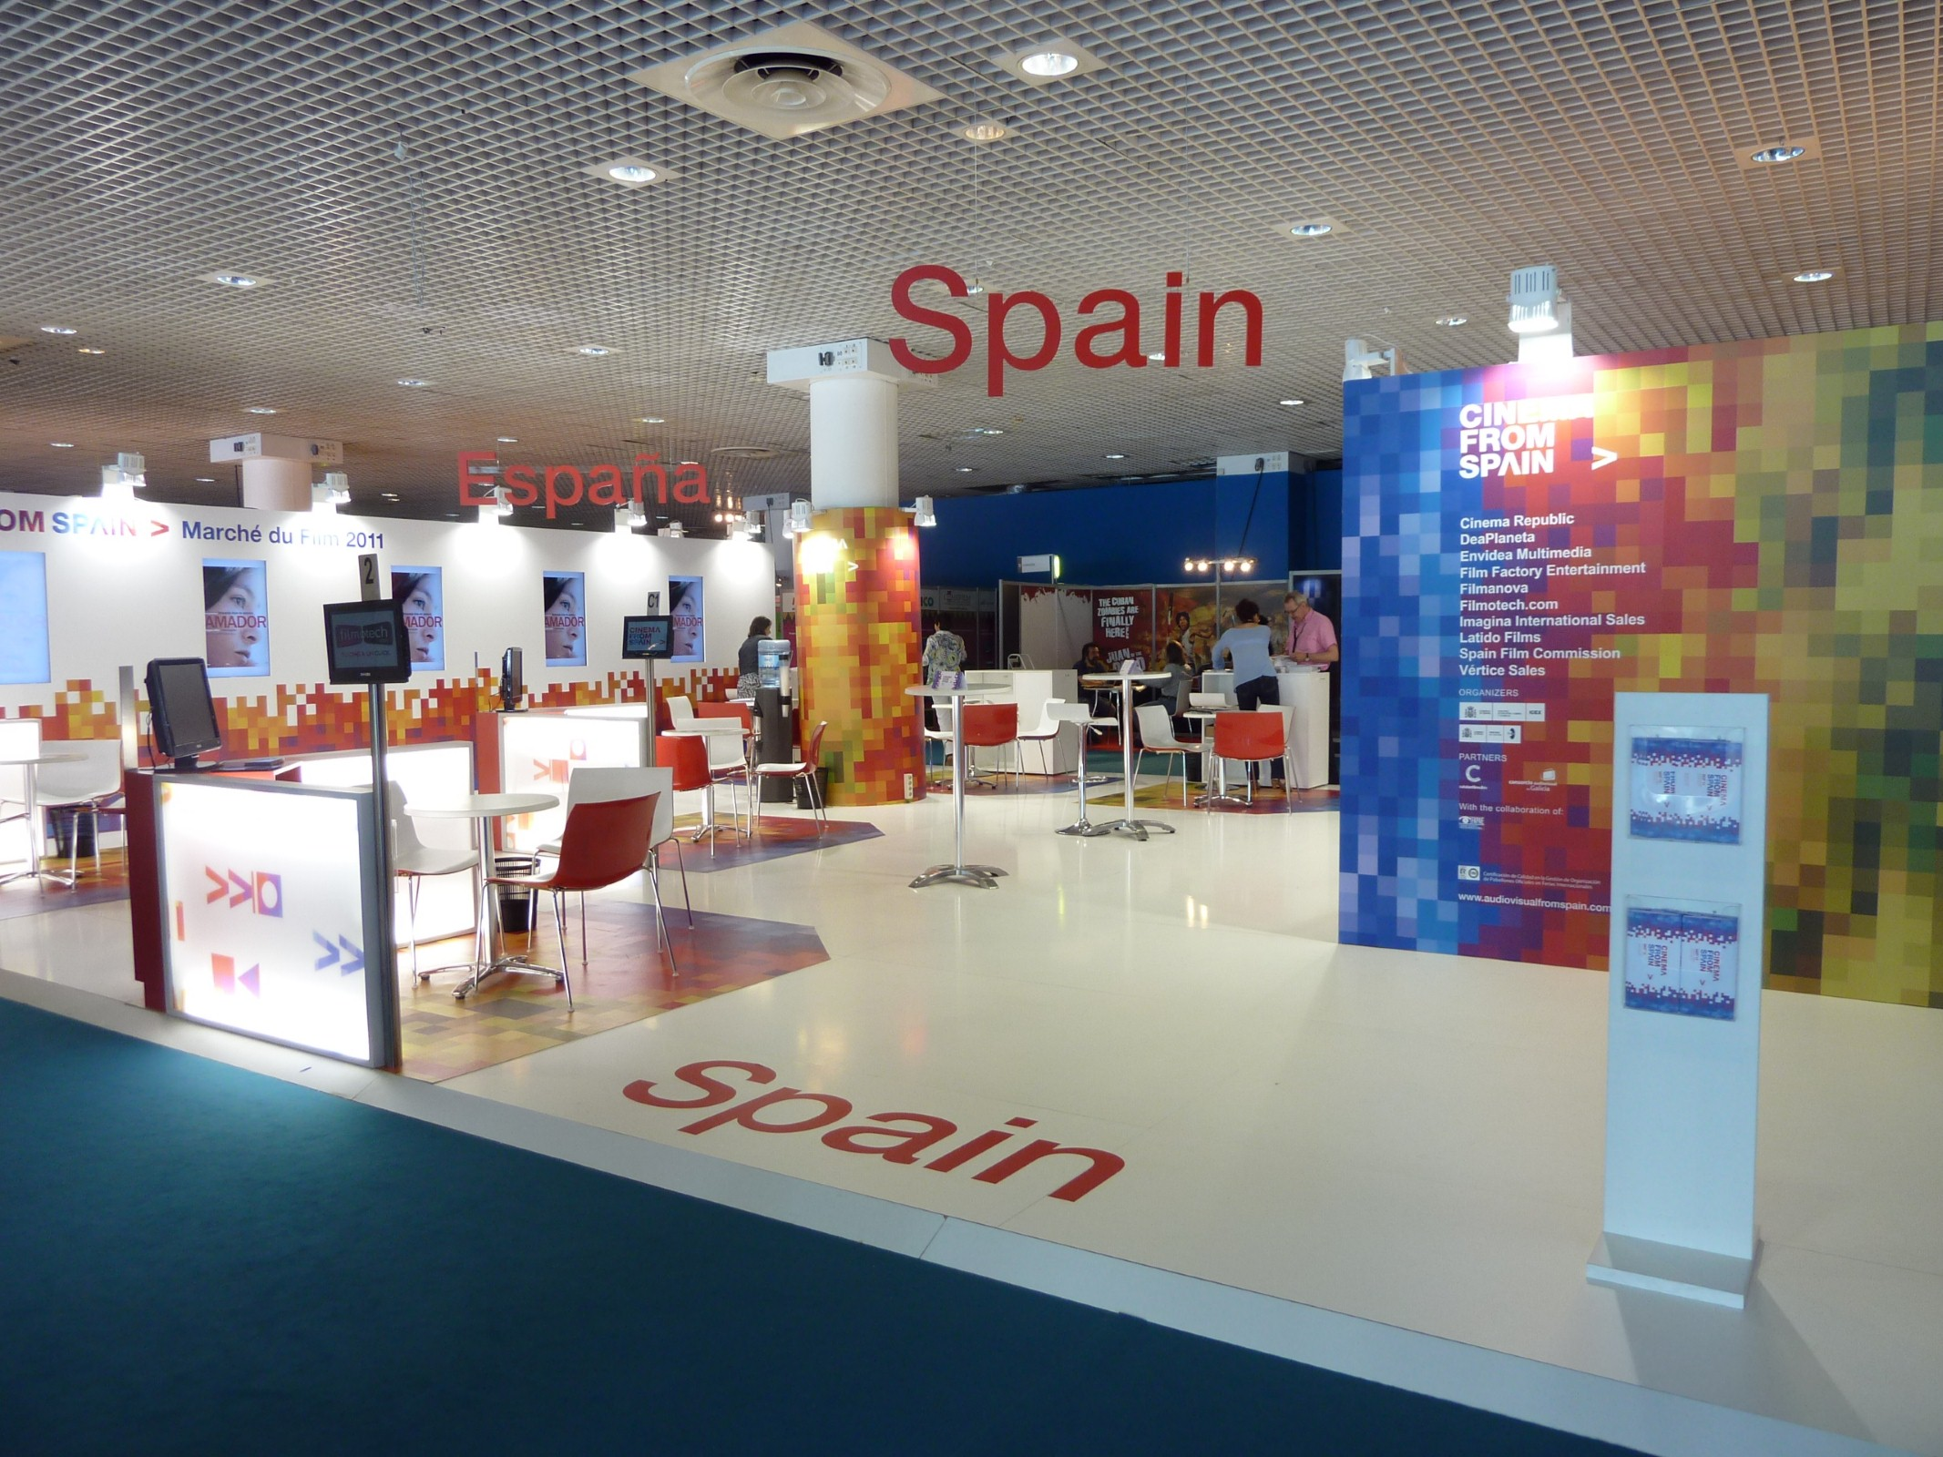
954 activities every year
with the participation of 22,577 companies.
Custom services for companies
providing 1,340 services every year.
Customised advice for every case
in response to 50,920 queries every year.
71 sector-specific
internationalisation plans every year.
Exports

Slide 8

We cooperate
with chambers of commerce, regional authorities and business organisations…
… in order to create synergies and enhance internationalisation capacity.
Cooperation

Slide 9
96
2
actions at trade fairs in 18 countries, with 1,137 business participations and 884 beneficiary companies.
Business Meetings with strong institutional support, with the participation of 375 Spanish and local companies.
69
15
trade missions with participation in 145 business actions.
Multilateral Partnership Meetings Technical Workshops, with strong institutional support.
293
291
activities such as promotional campaigns, technical seminars, exhibitions and public relations initiatives.
new companies participating in
the ICEX Next programme..
10.23
1,343
euros in returned exhibitor fees, benefiting more than 1,500 companies.
Customised services arranged and 2,365 units billed.
Figures for 2020

Slide 10
821
30,198
beneficiaries of the ICEX Scholarship Programme
Spanish company users with services granted in 2020.
141
57,709
training actions on market analysis, taking part in 8,038 business actions.
companies registered in the Virtual Classroom
50,924
870
queries resolved through the Ventana Global service, addressing the needs of 27,916 companies.
Industry reports and 465 country information documents, published on www.icex.es
40
69
project managed by ICEX-Invest in Spain have helped to create 12,064 jobs.
Trade missions with participation in 145 business actions.
Figures for 2020

Slide 11

What do we offer?
Solutions for every company…
…to take their first steps.
…to consolidate exports.
…to start up operations or invest abroad.
…to attract investment to Spain.
Information, advisory and training services
Services

Slide 12

What will you need to do to start exporting?
If you have not yet taken the first steps,
ICEX can help you as the starter point.
Starting out

Slide 13

Draw up a strategy
ICEX Next can help you
draw up the right strategy
Specialised professionals will help you set up
a strategy for internationalisation
and consolidation abroad.
ICEX co-finances 50% of expenses,
up to a maximum of 15,000 €.
www.icex.es/icexnext
Starting out

Slide 14

To consolidate exports
If you are already exporting and wish to consolidate your sales, ICEX can act as your partner and help you open up new markets.
Exports

Slide 15

Promote your company
We can support you in carrying out
promotion actions abroad:
Participation in international trade fairs.
Trade missions and study trips.
We can call buyers and opinion leaders out to find out about your product.
Technical and commercial meetings.
Promotion campaigns, public relations
and promotional materials.
www.icex.es/actividades
Exports

Slide 16

Bids in
multilateral tenders
We promote the participation of Spanish companies in tenders funded by multilateral organizations for the procurement of goods, works and services
  Updated information guides on organizations and market research.
  Identification of business opportunities (ICEX ON service).
  Training (master degrees, advanced courses and NOOCs).
  Promotional activities (multilateral partnerships meetings, seminars and conferences).
  Specialized support services, including guidance on tendering processes.
  www.icex.es/organismosmultilaterales
Exports

Slide 17

Setting up
operations abroad
If you plan to set up operations abroad, ICEX will promote your project and help you out.
Setting up operations

Slide 18

Finding partners
We organise Fora on Investment and Business Cooperation, and Business Meetings.
  Identification of opportunities for investment
  and cooperation.
  Organisation of interviews with potential partners.
  Institutional support at the highest level.
www.icex.es/actividades
Setting up operations

Slide 19
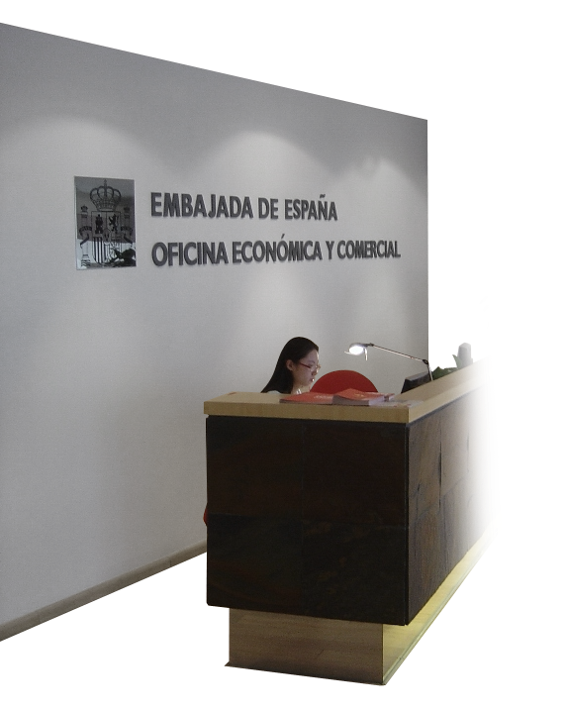
Helping you
to set up operations
If you are in need of temporary infrastructure in the country of destination
Business Centres
  Located in the Spanish network of Economic and Commercial Offices abroad.
  Offices and meeting rooms available for rent.
  Customised advice.
  Administrative and logistics support.
  www.icex.es/suoficinaenelexterior
Desafía Programme
Facilitates the entry of Spanish SMEs into the world’s most innovative technological ecosystems so they can grow as entrepreneurs.
https://www.desafia.gob.es/
Setting up operations

Slide 20

How to attract foreign investment and funding for projects in Spain
Through Invest in Spain, we help find foreign investment and offer advice:
Building the right climate for investment.
Transmitting an image of Spain as a competitive country
with high-level human and technological resources.
www.investinspain.org
Foreign investment

Slide 21

Services to attract
investment and funding
Identification of foreign investors and potential partners in Spain.
Organisation and coordination of visits and inbound missions.
Support in finding finance for joint investments.
Drafting of opinion surveys, and business climate analyses.
Search for regional and sectorial aid and incentives.
Creation of an Investor Network.
www.investinspain.org
Foreign investment
21

Slide 22

For every phase of the internationalisation process
ICEX provides full services related to:
Information.
Advice.
Training.
Full services

Slide 23

Full information
on foreign markets
www.icex.es:
the most widely-consulted Spanish-language Internet portal on internationalisation.
oficinascomerciales.es:
with specialised information
on the more than 150 markets covered
by the Spanish network of Economic
and Commercial Offices abroad.
emarketservices.es:
facilitates the use of
electronic markets.
comercio.es:
with other services from the
Secretary of State for Trade.
Information

Slide 24

And portals where foreign companies can find out about
Spanish products
www.spainbusiness.com
www.foodswinesfromspain.com
www.interiorsfromspain.com
www.audiovisualfromspain.com
Information

Slide 25
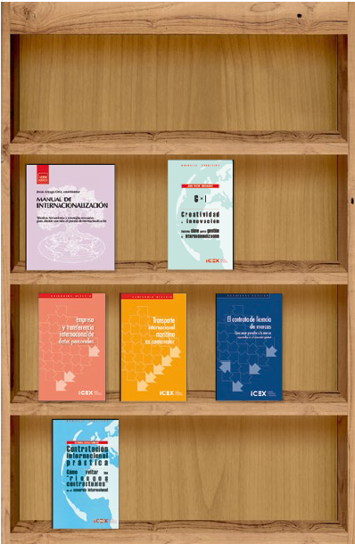

With publications and multimedia content
ICEX publications
More than 4,000 publications (international trade, manuals, business guides, country data).
www.icex.es/publicaciones
ICEX El Exportador
An on-line journal on internationalisation with news, reports, market information, videos and all the latest business topics.
www.icex.es/elexportador
Information

Slide 26

Find new business opportunities
The Business Opportunities Service provides updated information on demand for Spanish products and services, and on possible investment openings abroad.
www.icex.es/oportunidades
Information

Slide 27


Ventana Global
Ventana Global combines all the services and knowledge of the Spanish State Administration to help promote business internationalisation.
(+34) 913 497 100 | informacion@icex.es
A single, direct channel providing access to the resources of the Secretary of State for Trade, CDTI, CESCE, COFIDES, ENISA, ICEX and ICO.
Advisory Services

Slide 28

Customised services
ICEX provides customised advice and support, subject to a fee, through the Spanish network
of Economic and Commercial Offices.
Customised information on foreign markets.
Organisation of business meetings.
Identification of potential trade partners.
Logistics support.
Inbound missions.
With guaranteed quality control.
www.icex.es/serviciospersonalizados
Advisory services

Slide 29

Advice
on investments
To optimise your investment abroad
Advice on investments abroad.
Customised feasibility study, subject to a fee.
Assistance on funding for setting up operations abroad. ICEX will direct your company towards public and private sources of finance for your project, such as the Pyme-Invierte programme.
www.icex.es/asesoramientoinversiones
www.icex.es/pymeinvierte
Advisory services

Slide 30

Simulator of costs for creating a company abroad
In just a few seconds, you can calculate the cost of setting up your company in 100 markets.
Approximate start-up cost.
Comparison with other similar countries.
Amounts in local currency, euros or dollars.
Investment climate.
Full market information.
www.icex.es/simuladordecostes
Advisory services

Slide 31


Training in internationalisation
Because human capital is key in the process of internationalisation
Seminars and training
sessions throughout Spain.
www.icex.es/actividades
E-learning services
through the Virtual Classroom.
www.icex.es/aulavirtual
Internships on internationalisation:
285 interns received training
in Commercial Offices in 2020.
www.icex.es/becas
Specialised training
with ICEX-CECO programmes.
www.ceco.es
Training

Slide 32
Thank you for your attention
www.icex.es
(+34) 913 497 100

